Slide 1

Fakultas Ilmu Komputer
Learning is the process of acquiring new understanding, knowledge, behaviors, skills, values, attitudes, and preferences.
Latest Technology Trends

Slide 2

Trends in Computer Science Research

Slide 3
What is Advanced Technology in Computer?
Advanced technology is defined as a new or developing IT innovation that still has relatively few users, yet promises to provide future, significant value.
Technology terus diperbarui (constantly updating) dengan kecepatan yang begitu cepat sehingga tampaknya lebih cepat dari cahaya (faster than light).

Slide 4
Latest Technology Trends of 2021
Link: https://www.upgrad.com/blog/trending-technologies-in-2020/
: https://www.topuniversities.com/courses/computer-science-information-systems/5-trends-computer-science-research

Slide 5

1 - Artificial Intelligence

Slide 6
Artificial Intelligence
Artificial intelligence (AI) is the technology used for equipping computer systems with the ability to make decisions like humans. Being one of the trending technologies, when AI programs are fed to systems, the aim is to mimic human intelligence for performing complex tasks such as pattern recognition, speech recognition, weather forecast and medical diagnosis.

Slide 7
Artificial Intelligence
By 2030, AI automation is expected to create more than 70 million jobs. The sad fact is that AI might wipe out more than 23 million jobs by the same time frame. AI will create jobs in areas such as testing, support, maintenance, programming and data science.

Slide 8
Learning AI will help you secure jobs
Machine Learning Engineer
Data Scientist
Computer Vision Engineer
Business Intelligence Developer
Data Analyst

Slide 9
2 - Data Science

Slide 10
Data Science
Data Science is the technology that helps to make sense of complicated data. As we known that data is produced in a humungous amount every day by companies. This includes business data, sales data, customer profile information, server data, and financial figures.

Slide 11
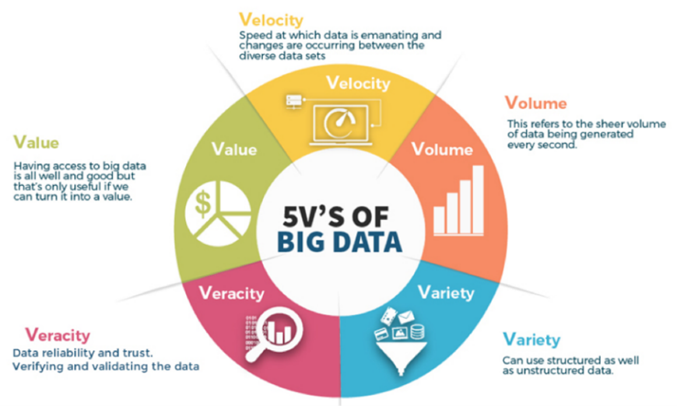
Data Science

Slide 12
Data Science
Most of this data (big data) is in the form of huge data sets that are unstructured.
The role of data scientists is to convert these unstructured data sets into structured datasets.
Then, these data sets can be analyzed to identify patterns and trends.
These patterns are useful for understanding the company’s business performance, customer retention, and how these areas can be improved.

Slide 13
3 - Internet of Things

Slide 14
Internet of Things
The IoT (Internet of Things) is a network of devices that are connected to each other. Their devices can interact and share data with each other. These devices may be connected via WiFi, and they share data about their environments and how they are being used. These devices have a computer chip that facilitates this exchange.

Slide 15
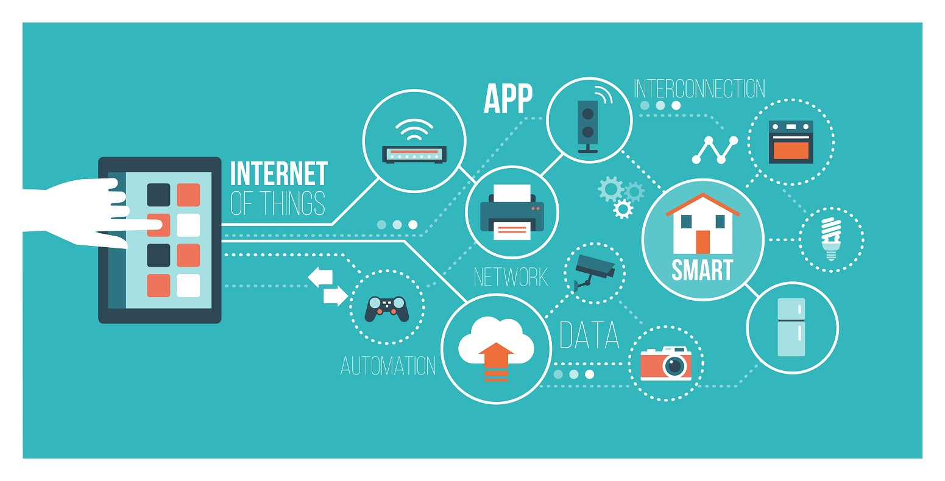
Internet of Things (IoT)
IoT not only enables the connection between different devices but also their remote access.

Slide 16
4 - Robotic Process Automation (RPA)

Slide 17
Robotic
Robotic Process Automation (RPA) is a technology used for automating daily tasks, similar to artificial intelligence. Here, the software is used for automating repetitive tasks such as handling and replying to emails, processing transactions, and handling business data.
This technology is used for automating tasks for low-level employees to higher-ranking officials. RPA can automate more than 40% of daily tasks.

Slide 18
5 - Intelligent apps

Slide 19
Intelligent Apps
Intelligent apps are software applications that make use of AI components such as machine learning, deep learning, data analytics, robotics, and natural language processing. They help you in making decisions based on real-time data or historical data.
Examples of Intelligent apps are voice assistants such as Siri, Google Assistant, and Alexa. As companies such as Google, Apple, and Oracle continue investing in these applications, it is bound to create a lot of jobs in the future.

Slide 20
6 - Cyber security

Slide 21
Cyber security
According to the US Bureau of Labor Statistics, cyber security jobs are predicted to grow by 28 percent between 2016 and 2026 – much faster than average for all occupations, and raising concerns about the shortfall in qualified graduates.
In February 2015, Barack Obama spoke of the need to “collaborate and explore partnerships that will help develop the best ways to bolster our cyber security.”

Slide 22
7 - Bioinformatics

Slide 23
Bioinformatics
A fascinating application of big data, bioinformatics, or the use of programming and software development to build enormous datasets of biological information for research purposes, carries enormous potential.
Linking big pharma companies with software companies, bioinformatics is growing in demand and offers good job prospects for computer science researchers and graduates interested in biology, medical technology, pharmaceuticals and computer information science.

Slide 24
8 – More Technologies

Slide 25
More Technologies
OpenCV
Face Recognition
Multiple Face Recognition
Detect Objects in Real-Time
COVID-19: Face Mask Detector
Age Detection
Eye blink detection
Developing a facial recognition security system
Detect eyes, nose, lips, and jaw

Slide 26

THANK YOU
END PRESENTATION
Thank you for your attention
Instructor: S – W – T

